Slide 1

Psychology 111
Laboratory in Personality and
Clinical Assessment
Jack Wright
Brown University

Slide 2
Agenda
Projective methods:
  Rorschach
  Chapman & Chapman
  Readings
    Groth-Marnat
    Lillienfeld
    Chapman & Chapman
  Quick reference guides (see handouts)
  Exercise, with timeline (see handout)

Slide 3
Agenda
Announcements
  FFM labs returned
    Individual comments
      see bins on 2nd floor; or see Mr. Dube, rm 270
    General comments
      see handout
    Procedures for questions
      printed, attached to report
      to me
      reviewed & returned
  NEO lab due Fri. 11.12.10
    time in section and/or class next week

Slide 4
Rorschach Administration, Scoring and Interpretation
1. Administer: association & inquiry phase
2. List the sequence of codes for each response
3. Record frequencies for each variable
4. Perform calculations required to obtain the ratios, percentages and derived scores
5. Consult norm tables and diagnostic profiles
6. Interpretive report

Slide 5
Scoring: Decoding protocol into “Sequence of Scores”
Area on card (NB) (we will not use)
Response # (NB)
“Location” , with “developmental quality” subcodes.
“Organizational activity”
Popular responses.
Specific percept
Pairs.
“features responded to”

Slide 6
So far...
“Location” + “Developmental Quality”
  Whole, Common Detail, Unusual Detail, Space response
  “Developmental quality”: “degree of meaningful organization”
    Synthesized, synthesized w/o form demand, ordinary, vague
“Determinants”: “features or aspects responded to”, including
  Form, Movement, Color, Shading
  Pairs: identical figures (2) or reflected forms (Fr)
Form Quality: “How accurately percept relates to form”
  Superior , Ordinary, Unusual, Minus/distorted

Slide 7
Content Codes
“Type and quantity of specific percepts in the responses” (see Table 9-5)
  Whole human, H or (H)
  Human detail, Hd or (Hd)
  Human experience
  Whole animal
  Animal detail
  Anatomy
  And others
(continues…)

Slide 8
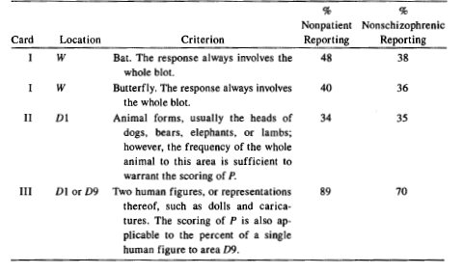
Popular responses (see Table 9.6)
Responses that are commonly given to each card
  EG: Card I: W, “Bat”, “Butterfly”

Slide 9
“Organizational Activity”
“[T]he degree of organization required to integrate the form described in the response.”
  “A Z score is assigned to any response that includes form and meets at least one of the following criteria:”
    ZW W (whole) response with developmental qualilty of + or v/+
    ZA 2 or more adjacent objects in relation
    ZD 2 or more distant objects in relation
    ZS White space is integrated with other areas
Notes:
15 sepcial scores - unusual verba;lizations and aggressive movement
Special indices - reorg and comparisons of scores from different catgeories

Slide 10
Scoring of Z values
Notes:
15 sepcial scores - unusual verba;lizations and aggressive movement
Special indices - reorg and comparisons of scores from different catgeories

Slide 11
Obtaining Zf and Zsum from “Sequence of Scores”
“Zf” = # times Z score occurred
15
“Zsum” = sum of Z scores
42

Slide 12
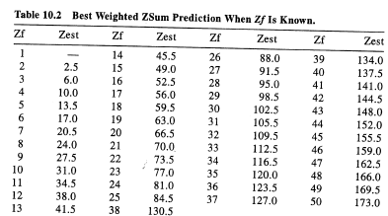
Obtainining “weighted” Zsum scores
“Weighted Z, from Table 10.2”

Slide 13
“Structural summary”
Other scores not
Discussed.
Summary of “Organizational activity”
# of each code on previous
# of each developmental quality (DQ)
subcode attached
# of form quality codes
Human
Movement
FQs with
W or D codes

Slide 14
“Structural Summary”
Integrates several pieices of information generated by the code summary, including
  “Lambda (L)”: “Relates to issues of economizing the use of resources.” (Exner, 1999)
  “Experience Balance” or “EB”: Measures “the dominant style of decision making activity.”
  “Experience Actual” or “EA”: “Available resources”; “Capability to initiate deliberate action in coping situations.”
Notes:
15 sepcial scores - unusual verba;lizations and aggressive movement
Special indices - reorg and comparisons of scores from different catgeories

Slide 15
Explanations of Lambda (Nurse, 2007)
“[A] high Lambda index (> .99) reflects a pervasive processing simplification that occurs when some elements of the field are consider of less importance when judged against the needs of the subject plus the perceived demands of the situation…The interpersonal consequences of this style are that the individual may fail to meet some family and social expectations and may deviate from socially expected patterns… For example, a high Lambda teen may be expressing a general Lambda coping style that ignores elements of a complex situation, with the resulting behavior becoming inadvertently confrontational.”
“In contrast…the low Lambda style implies a failure to see simplified solutions, with resulting over-involvement leading to an experience of being overwhelmed… In this case, a therapist may look for ways to strategically simplify and structure a session so as to help a low Lambda family member from becoming overwhelmed by whatever difficult feeling emerges (e.g., anger)”

Slide 16
Explanations of EB
“The Experience Balance (EB) indicates a relationship between human movement responses and the (weighted) sum of chromatic color responses (C). When the balance is more toward M, a person, labeled introversive, is likely to use his or her inner life as a primary source of satisfaction; when the balance is in the direction of C, an individual is described as extroversive, placing more emphasis on interactions between self and the world as sources of gratification…The introversive more often likes to delay, push feelings aside, look at all possible alternatives, and then make decisions. By contrast, the extroversive merges feeling with thinking while seeking to solve problems and reach decisions by more emphasis on interactive, trial-and-error behaviors… Although effective people tend to be either introversive or extroversive, being rigidly and pervasively one or the other, regardless of circumstance, is a liability…”
  (Nurse, 2007, paraphrasing Exner, 1993, p. 410)

Slide 17
Computing Lambda from Score Sequence
“F” = # responses with
Pure Form determinants
“R” = Total # responses
# Pure Form
L =
Total - # Pure Form
6
= .32
25 - 6
25
6

Slide 18
Computing EB from Score Sequence
Step 1: Count component scores
Form-Color (FC) = 4
Color-Form (CF) = 4
Pure Color (C) = 0
Step 2: Integrate Compute WsumC = .5*FC + 1*CF + 1.5*C
WsumC = .5*FC + 1*CF + 1.5*C
= 2 + 4 + 0
= 6
Step 3: Record EB ratio of Movement quality
(see previous) and WsumC
EG: EB = 5:6.0

Slide 19
“Structural summary”
Lambda
Total # responses
EB ratio
Experience actual

Slide 20
Illustrative Interpretive Questions (from Exner, 1999)
What is the quality of the person’s self-focus?
With what frequency and efficiency does the person try to organize his/her environment?
With what balance and passivity does the person interact with his/her environment?
How will the person respond to the affective stimuli of his/her world?

Slide 21
Illustrative interpretations
Number of W responses
  described as linked to general intelligence
Movement response
  said to suggest strong impulses or high motor activity
Low response rate
  said to be associated with mental retardation, depression, and defensiveness
“Confabulatory” responses
  said to be signs of a disordered state

Slide 22
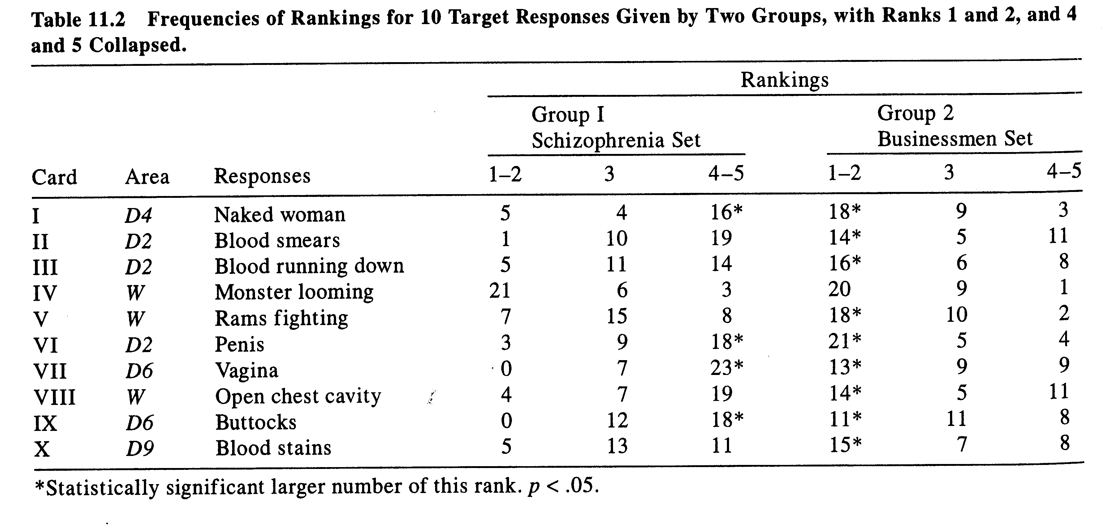
Illustrative actuarial data (Exner, 1999)

Slide 23
Sample “Constellations”: HVI, OBS
Eg: High organizational activity (Zf)
and form quality (FQ) responses.
Eg: high organizational activity (Zf)
and space response (S)

Slide 24
Sample “Constellations”: Depression
Eg: High Color-Shading blends (Col-Shd),
high shading (SumShading),
high form-vista (FV)

Slide 25
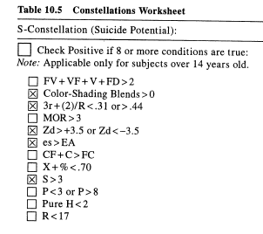
Sample “Constellation”: Suicide potential
Eg: Uses color-shading blends,
high use of space, high or low
organizational activity.

Slide 26
Illustrative use of Rorschach: Mike Tyson

Slide 27
Illustrative use of Rorschach: Mike Tyson

Slide 28
Questions about Exner’s CS system (see, eg, Lilienfeld et al. 2001)
1. Questionable status of norm groups
  Often unclear how samples were formed
  Selective summary statistics provided
    underlying distributions not provided
2. Questionable publication pattern
  Exner’s CS is the primary citation
  Most studies cited by Exner are self-citations
  These self-citations are not published in peer-reviewed scientific journals
    EG: “Exner (1989) … Unpublished research”

Slide 29
Questions about Exner’s CS system
3. Little or no access to these “source” studies
  Wood, Nezworski, Stejskal (1994)
    Each selects topic (e.g., narcissism)
    Write to E for copies of unpublished studies
    Exner offers vague explanation; studies not provided
  Request repeated, assistant responds:
    “The majority of these are not written in a publishable form. Instead, they usually include a brief statement concerning the methodology of the study…” Further inquiries reveal: “statements” about methodology/findings apparently “handwritten notes on sheets of paper or on computer printouts”

Slide 30
Questions about Exner’s CS system
3. Little or no access to these “source” studies….
  Per APA standards, others formally request access
    Exner did not respond or declined, citing difficulty locating materials
  Other data integrity questions
    Exner (2001) disclosed that 221 (41%) of his norm subjects were mistakenly duplicated
    Error not detected for over 20 years

Slide 31
Questions about Exner’s CS system
4. Little or no “incremental validity”
  Issue is NOT whether clinicians make interesting inferences from a Rorschach session
  Inferences may be guided by other information
  In some cases, inferences have no diagnostic value
    “Barnum” effect
  Even when inferences are useful, simpler procedures may do as well
    Less training, less costly, more reliable
    EG: MMPI

Slide 32
Society for Personality Assessment (SPA) rebuttal of Lillienfeld et al.’s critique (Weiner, 2005)
1. “Although some critics have questioned the psychometric soundness and legal suitability of Rorschach assessment, their criticisms lack any solid conceptual or empirical basis.” (Weiner, 2005, p. 82)
2. “[P]sychological assessment instruments perform as effectively as measures in a variety of other health services areas, such as electrocardiograms, mammography, magnetic resonance imaging (MRI), dental radiographs, Papanicolaou (Pap) smears, Positron Emission Tomography (PET) scans, and serum cholesterol level testing.” (p. 219)
3. “The Rorschach possesses documented reliability and validity similar to other generally accepted test instruments used in the assessment of personality and psychopathology.... (p. 221)
4. “[T]he Rorschach meets the variety of legal tests for admissibility [in courts]”… “its responsible use in personality assessment is appropriate and justified” (p. 221).

Slide 33
Questions about Exner’s CS system
Wood et al.’s (2006) summary of Society for Personality Assessment (SPA) responses to their critiques:
1. The review Board consisted only of Rorschach proponents; critics were not invited to participate.
2. The Board failed to respond to the contrary evidence already cited in past reviews.
3. The Board failed to endorse APA standards for clinical practice by recommending that psychological test scores -- including Rorschach scores -- should be used only for purposes for which they have been specifically scientifically validated.
4. The Board failed to consider potential for harm to clients who are mis- or over-diagnosed, especially in forensic settings.
5. The Board continues to promote Klopfer’s original notion that the Rorschach is the psychological equivalent of an x-ray by suggesting that is as effective as modern radiographic techniques such as mammograms, MRIs, and PET scans.

Slide 34
Questions about Exner’s CS system
“We sincerely regret that the SPA Board missed these opportunities to rehabilitate the Rorschach’s reputation in the broader scientific community. Rorschach proponents sometimes express surprise, dismay, or irritation that their inkblots excite strong controversy among research-oriented clinical psychologists. However, the reason is not hard to find: From the time of Lee J. Cronbach, Hans Eysenck, and Joseph Zubin up until the present, legitimate scientific criticisms of the test have been adamantly resisted or ignored by Rorschach proponents (for a historical summary, see Wood, Nezworski, Lilienfeld, & Garb, 2003). So long as proponents continue to dismiss legitimate criticism, ignore negative research, and present the test as the psychological equivalent of medical imaging techniques, the Rorschach is destined to remain on the fringes of psychological science.” (Wood et al., 2006)

Slide 35
Projective Exercise
See handout
1. Practice with Rorschach
2. Run self as subject in Chapman & Chapman replication
3. Recruit and run subject ($5 allowance)
  Projective test
  Chapman & Chapman replication
4. Score Projective responses & enter own and subject’s C & C data
5. Brief team report

